Slide 1

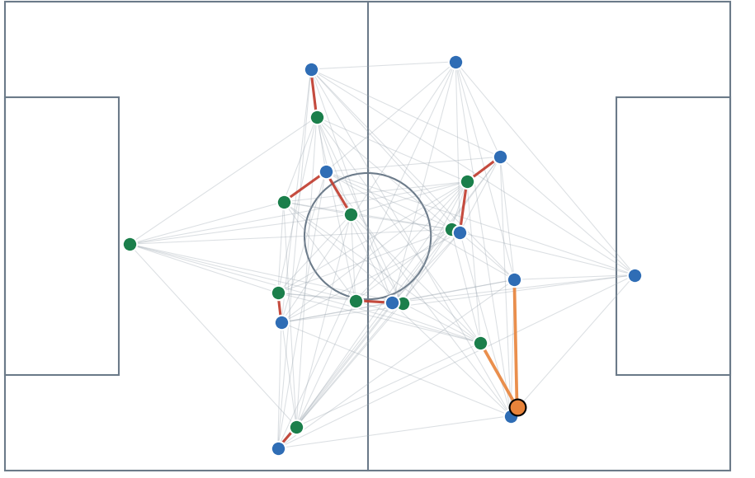
DYNAMIC TACTICAL AI IN FOOTBALL
From tracking data to football movement models
RESEARCH PROGRESS
Can an AI learn
what players do next?
Progress review • 19 October 2026
Srinivasan Dhakshanamoorthy
MSc Data Engineering & AI | ESILV / DVRC
REAL MATCH • player relationships at one moment
Supervisor: Prof. Ahmed Azough
1
Notes:
Introduce the research question in simple terms. We convert tracking into snapshots, connect the players and the ball as a graph, and train a model to predict the next positions. The current achievement is the movement-learning foundation; tactical decision support is later work.

Slide 2
DYNAMIC TACTICAL AI IN FOOTBALL
Project flow: each step adds football context
1
2
3
4
5
6
DATA
COMMON FORMAT
KEY STATES
SEQUENCES
PLAYER GRAPHS
GNN + GRU
Real + simulated
Same pitch & units
Keep meaningful changes
Group play episodes
Encode relationships
Predict next positions
WHAT COMES OUT TODAY
A forecast of how each player and the ball move before the next Key State.
Foundation built
Tactical decisions: next stage
2
Notes:
Explain that every step converts raw data into a representation with more structure. We begin with coordinates and end with one predicted displacement per player and ball. Sequence grouping and tactical interpretation are not the same thing: broad sequence groups are done, while tactical state meaning is in progress.

Slide 3
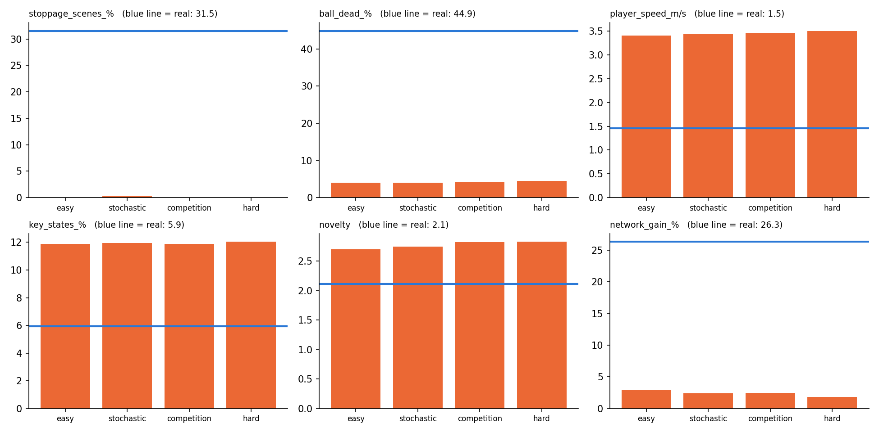
DYNAMIC TACTICAL AI IN FOOTBALL
Data: real matches are the reference
COMMON COORDINATE SYSTEM
Every feed is aligned to the same 105 × 68 m pitch, in metres, at 10 frames per second.
7
36
4
real DFL matches
simulated GRF matches
simulation styles
The simulator now covers easy, stochastic, hard and competition settings.
But all four remain about 85% away from real matches on the project’s combined realism score.
3
Notes:
We now have seven real DFL/Sportec matches and 36 simulator matches across four settings. All use one shared format: metres on a 105 by 68 metre field, sampled at 10 Hz. The real matches remain the benchmark. The simulator realism scorecard shows that difficulty variety alone has not made the generated movement much closer to real football; scorecard gap is around 85 percent for these settings.

Slide 4
DYNAMIC TACTICAL AI IN FOOTBALL
Key States and sequences reduce repeated frames
KEY STATE
SEQUENCE
Keep a frame when the combined change since the last kept frame reaches 3 m.
Neighboring Key States are grouped into episodes using changes in shape and speed.
VARIABLE-LENGTH EPISODES
40%
40%
20%
The 5-second window is used to detect a change around a candidate boundary; resulting episodes can be longer or shorter.
players move
team shape changes
ball moves
SIMULATED MATCHES
WHAT THE PIPELINE FINDS
REAL MATCHES
Nearly all scenes are labelled active play in the current simulator.
active play
stoppage
39% of detected boundaries sit near recorded events (random: 21%).
4
Notes:
A Key State is an event-independent snapshot selected when the players’ movement, arrangement, or the ball has changed enough. The current score is weighted 40 percent player movement, 40 percent arrangement change, 20 percent ball movement, with a 3 metre threshold. Sequences are broad episodes built from geometry. Their types consistently look like active play and stoppages in real matches. The reported event-near-boundary fraction is 39 percent, compared with 21 percent for randomly chosen boundaries.

Slide 5
DYNAMIC TACTICAL AI IN FOOTBALL
Player graphs represent relationships at each Key State
23 nodes
REAL MATCH GRAPH
11 home players + 11 away players + the ball
TEAM
Who are my teammates?
OPPONENT
Which opponents are close?
BALL
Who is nearest to the ball?
Each node also stores position, speed, role, team, and ball distance.
5
Notes:
Use the graph picture to explain the structure. A dot is a player or the ball. Three edge types keep teammate, opponent, and ball relationships distinct. The feature vector captures position and velocity, role and team, distance to ball, and whether a player slot is present. This gives the model football context beyond a flat list of coordinates.

Slide 6
DYNAMIC TACTICAL AI IN FOOTBALL
Graph types and graph layers: simple versus specific
TWO GRAPH-BUILDING OPTIONS
WHY COMPARE GCN, GAT, AND OUR LAYER?
RADIUS GRAPH
GCN
A simple average of neighbor information.
Connect all teammates; link opponents within 8 m; link the ball to its 3 nearest players.
GAT
Learns which neighbors deserve more attention.
OURS
Keeps teammate, opponent and ball links separate; learns a different message for each.
DELAUNAY GRAPH
Connect geometric neighbors in a mesh. Fewer links, without choosing a distance cutoff.
Purpose: test which relational bias helps prediction
Shared 3-fold results: all three models ≈1.11 m
Custom model: 7 folds. GCN and GAT: 3 each; more folds and seeds are needed.
6
Notes:
Explain the two graph construction options, then distinguish the three message-passing designs. The fair shared comparison currently covers three held-out real matches: our model, GCN and GAT each average about 1.11 m player-position error; keep-velocity averages about 1.52 m on those matches. The custom model has completed seven held-out folds, while GCN and GAT have three each. This is encouraging early evidence, not a final winner: finish the remaining folds and repeat across seeds.

Slide 7
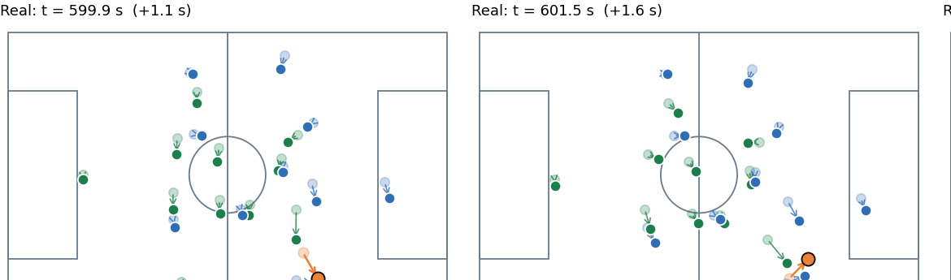
DYNAMIC TACTICAL AI IN FOOTBALL
GNN + GRU: learn space and movement over time
AT EACH MOMENT: GNN
ACROSS MOMENTS: GRU
The graph network passes messages between related players and the ball.
A GRU reads the last 3 Key States in order and remembers how each player was moving.
STATE 1
STATE 2
STATE 3
Where?
How changing?
Predict next
Why GRU?
A single frame shows where players are. The short history shows whether they are advancing, retreating, or turning.
7
Notes:
The graph neural network captures who is related to whom at one moment. The GRU is the time component: it reads the last three graph snapshots in order along with the time gaps. We need both because the same formation can lead to different next movements depending on whether it is advancing or recovering. This is supervised by future displacement from tracking, so no tactical labels are needed for this movement-prediction task.

Slide 8
DYNAMIC TACTICAL AI IN FOOTBALL
Movement prediction: results across all seven real matches
AVERAGE PLAYER POSITION ERROR (METRES)
Custom graph model
1.11 m
Keep current velocity
1.51 m
No movement baseline
2.88 m
7 / 7
≈26%
Simulation caution
real matches held out in turn
lower error than keep-velocity, averaged across folds
On simulator data, performance stays close to the keep-velocity baseline.
8
Notes:
This uses the full seven-fold evaluation for the custom model, one match held out per fold, each trained on the other six. Mean player error is 1.113 metres; keep-velocity is 1.511 and no movement 2.885. The custom model is roughly 26 percent better than keep velocity on real held-out matches. On simulator data, it does not beat the velocity baseline on average, so we must avoid saying it has generalized to simulated football. Seed count is currently one.

Slide 9
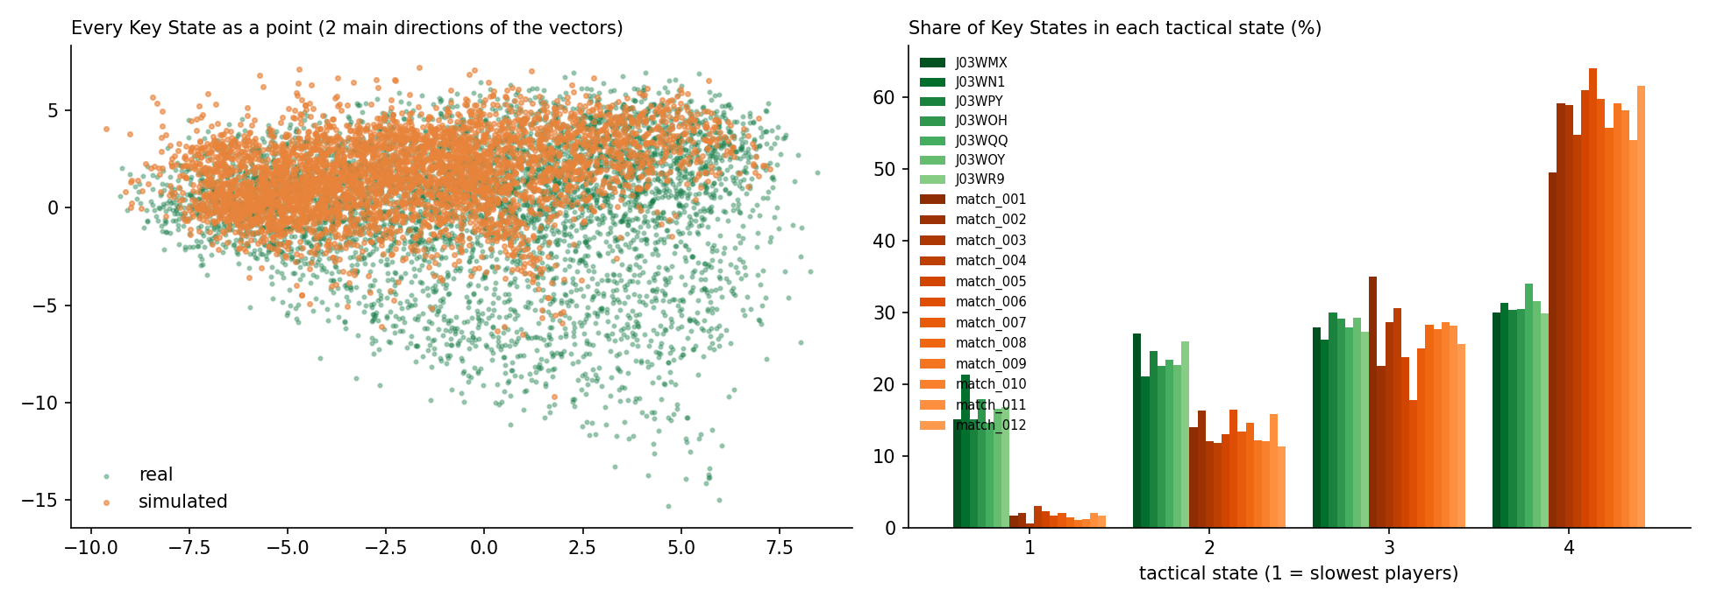
DYNAMIC TACTICAL AI IN FOOTBALL
What the current analysis can and cannot claim
COMPLETED ANALYSIS
• Embeddings are saved for Key States.
• Real/sim novelty comparison runs across seven real matches.
• Event-adjacent boundary detection tested: learned-score AUC ≈ 0.77–0.84 on real matches.
STILL EXPLORATORY
• Four clusters are not yet tactical labels; they mainly separate player speed.
• Near-perfect simulator event AUC is a warning about domain differences or shortcut signals.
Takeaway: a useful representation is emerging, but interpretation still needs football tests.
9
Notes:
Tactical clustering creates four groups from model embeddings. The groups are currently ordered strongly by player speed. They are not yet interpretable tactical states such as pressing block or attacking shape. Event-adjacent boundary detection with the learned score gives AUC values around 0.77 to 0.84 on real matches. Its near-one results on stochastic simulation should be investigated for domain-specific shortcuts.

Slide 10
DYNAMIC TACTICAL AI IN FOOTBALL
Next work: validate, interpret, then test decisions
1
Complete model comparison
Run GCN and GAT on the remaining held-out matches; compare all seven and repeat with several seeds.
2
Check the inputs
Confirm the Key State definition and verify simulator time scaling.
3
Make states tactical
Cluster using shape and line features; test interpretations with football events.
4
Build the tactics layer
Add formations, pass/receiver prediction and multi-step trajectories.
5
What-if simulation
Test alternative actions only after simulation realism improves.
Discussion with professor: prioritize full architecture validation, or start tactical-feature work in parallel?
10
Notes:
The next step is to complete GCN and GAT evaluation on the remaining held-out real matches and repeat with several seeds. Then validate the Key State definition and simulator time scaling, improve tactical interpretation using shape and line features, and build the tactics layer. What-if simulation comes after simulator realism improves. Ask whether full architecture validation should be prioritized before tactical-feature work.

